Slide 1



AG UNIVERSE
The Best E-School Platform!

Slide 2
AG UNIVERSE
The Best E-School Platform!

Slide 3
table of contents :
1.Our Team
2.Stages of Realization
3.Used Technologies

Slide 4
01.our team
And everything you should know about us;)

Slide 5
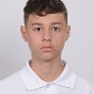
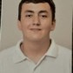
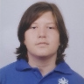
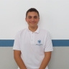

TEAM AG
Kaloyan Pozharliev
David Papazyan
Scrum Trainer
Designer
Georgi Pavlov
Konstantin Turmanov
BackEnd Developer
BackEnd Developer

Slide 6
02.stages of Realisation
And how we came up with the idea

Slide 7

stages of realisation
Our idea is to create an E-School platform that has multiple exams that you can complete for a grade, timetable, events and more, that can ease up your school experience!

Slide 8
03.used technologies

Slide 9










03.used technologies

Slide 10
LET’S GO!

